Slide 1
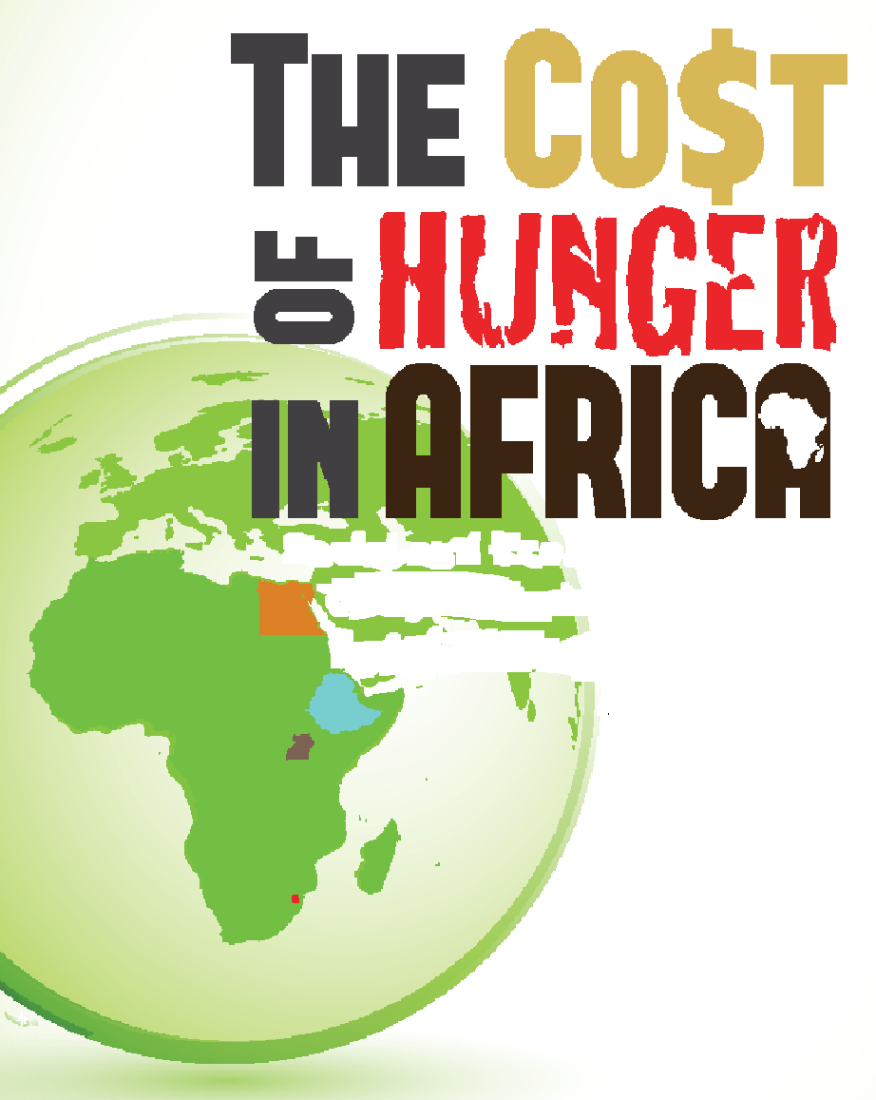



Briefing at the 3rd Capacity Development Symposium
Harare, 3-5 May 2016
Thomas Yanga, Director WFP Office to AU&ECA
Social and Economic Impact of Child Under-nutrition

Slide 2
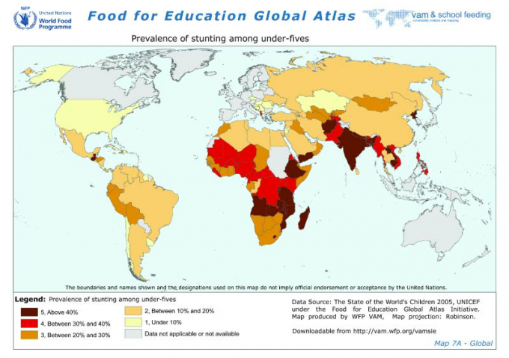
The Nutrition Challenge
Under-nutrition caused 45% of all child deaths in the world in 2013
> 90% in Asia and Africa.
Two billion people suffer from micronutrient deficiencies.
18 of the 20 hardest affected countries are in sub-Saharan Africa.
69-82% of all cases of child under-nutrition are not treated properly.
.

Slide 3
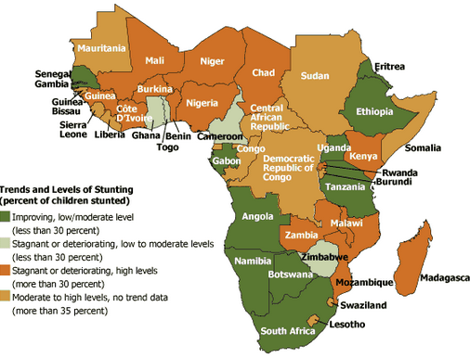
The Nutrition Challenge
Globally 162 million children under five years of age are stunted
  The majority (40%) of the world’s stunted children live in sub-Saharan Africa.
Globally, 51 million children are wasted.
  28% live in Africa.
Notes:
Highlight that the two last point are from the COHA
MND -> Although significant achievements have been made over the past decade, a more ambitious, concerted, and systematic effort is needed to tackle the challenges that still face many countries in Sub-Saharan Africa

Slide 4
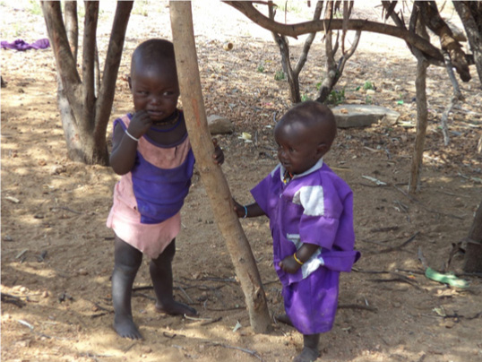
Stunting and Growth
Photo of Twins
Photo shows normal growth (taller child)
and stunted growth (shorter, thinner child)
Notes:
THE IMPACTS OF STUNTING AND UNDERNUTRITION ARE KNOWN
HOWEVER NUTRITION IS SEEN AS A HEALTH ISSUES
THE QUESTION IS HOW TO RAISE AWARENESS TO DECISION MAKERS THE IMPACT OF NUTRITION ON ECON DEVELOPEMNT

Slide 5

Cost of Hunger in Africa (COHA) Overview
COHA was initiated to raise the profile of malnutrition in Africa – demonstrate its far reaching consequences to economic development.
COHA was adapted for African Context, from a model developed by the Economic Commission for Latin American Countries - ECLAC.
Study is implemented by National Implementation Teams (NITs) – comprising multi-sectoral representation, and uses National Data – DHS, Household surveys, National Census etc.
It estimates the social and economic impact of child under-nutrition by quantifying costs to 3 sectors - Health, Education and Labour Productivity (and opportunity cost to labour force, derived from premature death).
Notes:
When findings were first presented to the Ministers of Finance and Econ Development, and they realized how much the economy was losing…Government realized that Nutrition is not just a health issue.

Slide 6
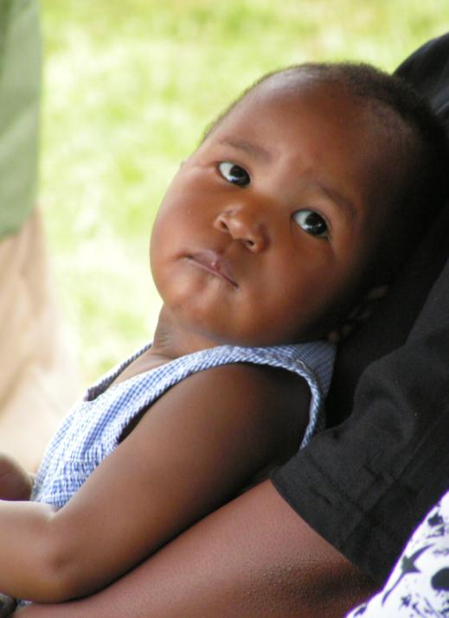
Effects on HEALTH
“Undernourished children have lower resistance to infection and are more likely to die of common childhood illnesses such as diarrhea and lower respiratory-tract infections.”
For every additional case of child illness, both the families and health system are faced with additional economic costs.
Increased cases related pathologies (ADS, anaemia, ARI, fever)
Notes:
Incremental morbidity Episodes; Stunted children are more likely to fall ill or die
Cognitive impairments experienced in early life have long-term consequences – loss in earnings

Slide 7
How much on Health?
 | Country
 | Egypt | Ethiopia | Swaziland | Uganda | Burkina Faso | Ghana | Malawi
Total (millions of USD) | 213 | 154 | 7 | 259 | 63 | 199 | 46
% of costs covered by the families | 73% | 89% | 88% | 87% | 58% | 70% | 49%
Public costs as % of health public expenditure | 1.60% | 2.30% | 0.60% | 11.00% | 4.5% | 4.1% | 19.5%
Total health costs as % of GDP | 0.10% | 0.50% | 0.20% | 1.60% | 0.60% | 0.5% | 0.8%
The economic cost of undernutrition ranged from values equivalent to 0.6% to 20% of government budget allocated to Health and from 0.1% to 1.6% of GDP
Notes:
Undernutrition contributed to 11 million incremental cases of illnesses in children under 5 years, in the studied countries

Slide 8

A child who is under-nourished is at risk of suffering from cognitive and physical impairment, which have impact on quality of life as a child and an adult within the society.
Stunted children are more likely to repeat grades in school or even drop out.
Effects on EDUCATION

Slide 9
How much on Education?
Country | % Repetitions associated with Stunting | Economic Cost |  | Proportion covered by the Families
 |  | Local Currency | USD (in millions)
Egypt | 10% | EGP 271 | 49 | 39%
Ethiopia | 16% | ETB 93 million | 8 | 64%
Swaziland | 12% | SZL 6 million | 1 | 70%
Uganda | 7% | UGX 16.5 billion | 8 | 45%
Burkina Faso | 5,8% | 853 millions FCFA | 1.7 | 75%
Ghana | 10,5% | 14,9 millions GHC | 8.3 | 66%
Malawi | 18% | 3,4 billions MWK | 13.9 | 35%
Rwanda | 13,5% | 2,4 billion RWF | 3.9 | 67%
Total |  |  | 93.8 | 46%

Slide 10
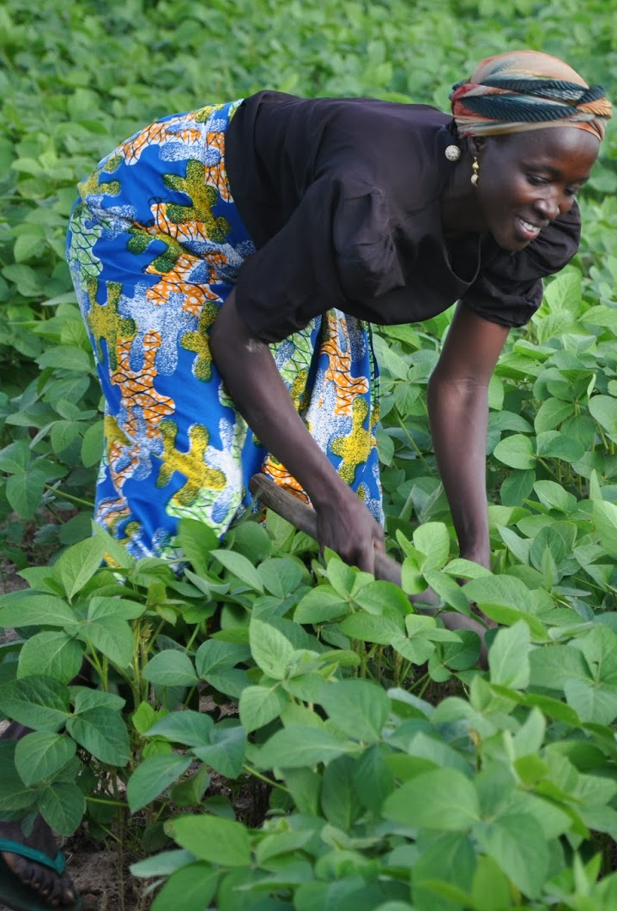
Various studies have shown that when a child is stunted, this will have an impact on him/her when he/she enters the labour force.
In general, stunted workers are less productive in manual and non-manual labour than non-stunted workers, and are less able to contribute to the national economy.
Effects on PRODUCTIVITY
Notes:
Study have demonstrate that stunted children earned at least 20% less income as adult than children who were not stunted.

Slide 11
How much on Productivity?
Country | Population of Working Age |  | Lost Productivity in |  |  | Lost Productivity in
 | (15-64) |  | Non-Manual Activities |  |  | Manual Activities
 | Number of People | Estimated stunting Prevalence | National Currency | USD | % of GDP | National Currency | USD | % GDP
Egypt | 20 Million | 40% | 2.7 billion EGP | 483 million | 0.30% | 10.7 billion EGP | 2 billion | 1.00%
Ethiopia | 26 Million | 67% | 616 million ETB | 52 Million | 0.20% | 12.9 billion ETB | 1.1 billion | 3.80%
Swaziland | 270 Thousand | 40% | 251 million SZL | 30 million | 1.00% | 126 million SZL | 15 million | 0.50%
Uganda | 8 Million | 54% | 218 billion UGX | 108 million | 0.70% | 366 billion UGX | 180 million | 1.10%
Burkina Faso | 4,7 million | 52% | 20,8 billion CFA | 40,8 million | 0.39% | 37,2 billion CFA | 73 million | 0.70%
Ghana | 5,5 million | 37% | 628 million GHC | 350 million | 0.86% | 319 million GHC | 178 million | 0.44%
Malawi | 4,5 million | 60% | 25 billion MWK | 102 million | 1.76% | 16,5 billion MWK | 67 million | 1.15%
Rwanda | 3,0 million | 49% | 40,4 billion RWF | 66 million | 0.98% | 86,5 billion RWF | 141 million | 1.98%

Slide 12
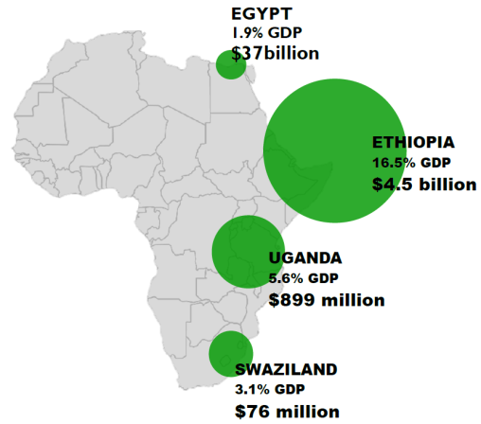
Economic Impact of Child Undernutrition
Country | Losses in Local Currency | Annual Losses in USD
Egypt | EGP 20.3 billion | $3.7 billion
Ethiopia | ETB 55.5 billion | $4.5 billion
Swaziland | SZL 783 million | $76 million
Uganda | UGX 1.8 trillion | $899 million
Burkina Faso | FCFA 409 billion | $ 802 million
Ghana | GHC 4.6 trillion | $2.6 billion
Rwanda | RWF 503 billion | $ 820 million
Malawi | MWK 147 billion | $597 million
.
BURKINA FASO
7.6% of GDP
$ 802 million
Rwanda
11.5_% of GDP
$ 820 million
MALAWI
10.3% GDP
$ 597 million
The aggregate cost estimation for Health, Education and Productivity are equivalent to between 1.9% to 16.5% of GDP

Slide 13
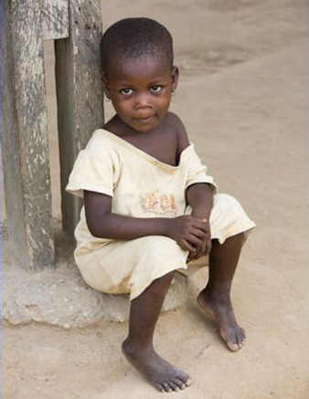
What are the potential savings of a reduction in child stunting prevalence?

Slide 14
Summary of Savings Scenarios
Country | Average Annual Savings
 | Scenario #1: Halving the Prevalence of Child Under-nutrition by 2025 (in million USD) | Scenario #2: The ‘Goal’ Scenario: “10% Stunting and 5% Underweight by 2025” (in million USD)
Egypt | 133 | 165
Ethiopia | 376 | 784
Swaziland | 3 | 4
Uganda | 88 | 131
Burkina Faso | 851 | 1,453
Ghana | 2,285 | 2,954
Malawi | 814 | 1,137
Rwanda | 149 | 184
Total | 4,700 | 6,811

Slide 15
10 Findings from from the Cost of Hunger in Africa Study *
1
Only one in five children suffering from under-nutrition receive adequate medical attention.
3
Most health costs associated with undernutrition occur before the child reaches the age of one year.
4
Between 7 to 18 percent of repetitions in school are associated with stunting.
5
Stunted children achieve 0.2 to1.5 years less in school education.
6
8 to 33 percent of all child mortality is associated with under-nutrition.
7
Child mortality associated with undernutrition has reduced national workforces by 1 to 13.7 percent.
8
40 to 67 percent of current working-age population suffered from stunting as children.
9
The annual costs associated with child undernutrition are estimated at 1.9 to 16.5 percent of the equivalent of Gross Domestic Product (GDP).
10
Improving the nutritional status of children is a priority that needs urgent policy attention to accelerate socio-economic progress and development in Africa.
2
Africa’s share in the world’s undernourished population has increased from 18 to 28 percent .
* based on the results from the first 8 countries countries.

Slide 16
Some Concluding Facts
Undernutrition is responsible for 45% of all under-five deaths.
Stunting is irreversible, but preventable.
Prevention is cost-effective: $1 invested can yield $16
A 10% increase in GDP leads to a 6% reduction in stunting.
Malnutrition is multi-causal-> must focus on nutrition-sensitive, as well as nutrition-specific programming.
Governments need support to address the underlying causes.
Partnerships are essential for a multi-sector approach.
COHA demonstrates the heavy costs governments are paying in terms of GDP and development, but it also has severe consequences for the community, the family and the child.

Slide 17
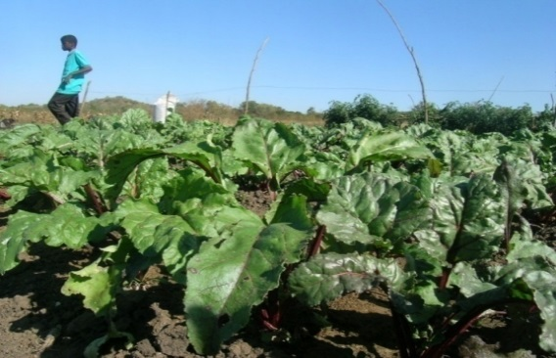
Going Forward
Continued collaboration with Member States and donors to enhance nutrition advocacy efforts.
2016 - Ongoing studies – Chad, Ghana, Madagascar, Mauritania, Mozambique, Lesotho, Mali, DRC, Zimbabwe.
Complete studies in a few more Countries (2016 -17)– including Nigeria, South Africa – undertake regional comparisons.

Slide 18

Going Forward
Online Data repository – with a dataset of over 20 Countries, data can be made available for “public good” - additional analysis and research - inform policy.
Expand the continental analytical capacity.
With ECLAC – adapt the methodology to analyze “cost of closing the gap” – identify and cost nutrition/nutrition- sensitive response.
Continue with M&E and progress reviews of the countries to ensure COHA is creating sustained impact on nutrition issues.

Slide 19
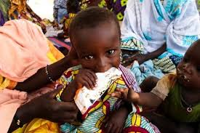
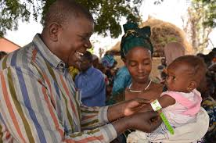
Working together we can make a difference
A healthy childhood is an important and vital precondition to development. Addressing stunting is a first and crucial investment to build the foundation of the economic and social transformation of Africa.
(Malabo Declaration, SDGs, Agenda 2063)

Slide 20
Thank You
Merci

